Slide 1
Capstone Project
Workforce Analytics
Submitted by:
PGP-DSE Gurgaon Jan’21-Group 7
Siddhanth Rawat
Pragyansh Sharma
Ritu Dhounchak
Divyanshi Verma
Urvashi Rawat
Under the Supervision of:
Mr. Vikash Chandra

Slide 2
Problem Statement
Company Information
NewJob_partner is a recruitment agency that specializes in providing efficient resources to various companies working in different fields.
Alpha Private. Limited has two positions open for the role of JR. Data analyst and senior data scientist. The job description for both the posts is as follows:
Junior Data Analyst: Experience 0-3 years
Stem Graduate, Any Postgraduate
Humanities and Business degree not required
Senior Data Scientist: Experience 10 or more years
Stem Graduate, Any Postgraduate, Any PhD
Humanities and Business degree not required
Alpha Private Limited collaborated with NewJob_partner to assist them in selecting the right candidate for the newly opened post.
NewJob_partner's databases contain information about a candidate's skills and experience and they apply various data-driven algorithms to analyze the gathered information of various candidates so that it can be used in valuable insights about a specific candidate's professionalism and preferences which proves out to be an excellent approach when filtering candidates as per client’s requirements.
Problem Statement: Estimate the likelihood of an applicant searching for a new career

Slide 3
1. Dataset Description
The dataset primarily focuses on the various
factors which might be affecting the job change
which directly helps us to identify the factors for change .
The Various types of columns present in the data are :
Column Type | Count
Numerical | 5
Categorical | 9
2. Data Preprocessing
Various Columns Treatment
Outlier Detections and Treatment
Missing Values and its treatment
Remove missing values from the data and make sure that the new imputed values don’t harm the integrity of the data.
Perform transformation on numerical data containing outliers.
Conversion of categorical columns to numerical and removal of unique value columns to make data suitable for analysis and modeling.

Slide 4

What inferences can be made out of the dataset ??
The ratio for job change for gender
Relevant Experience affecting the job change
Education level of the respective candidates
Major discipline's role is affecting job change
Experience and training of employees

Slide 5
The ratio for job change
The ratio of male, female and other in our data is 84%:14%:2%.
The ratio of job change is 75%:25%
The individual ratio of job within male, female and other is 28%, 24% 30% respectively.
The others are more prone to look for new employment followed by female.
Relevant Experience affecting the job change
People with no relevant experience are more likely to look for jobs.
The ratio for the same is 34% : 22%

Slide 6
Experience and training of employees
The employees with experience of 10+ are more reluctant to Change.
On average employees with 8 years of experience are willing for a job change.
Major discipline's role is affecting job change
Major Discipline | Avg. Training Hours
Arts | 60
Business Degree | 66
Humanities | 66
No Major | 66
Other | 66
STEM | 65
Employees with other STEM and business degree as major discipline more prone for job change if we see the people with their respective major disciplines only
All major discipline has an avg mean
training time of 65-68 hrs

Slide 7
Education level of the respective candidates
The maximum no. of candidates have graduate degree followed by masters and the lowest level of education is primary school.
Low people with higher education background Phd.
Statistical Analysis
Application of Chi-squared Independence of Attribute test represents that all the categorical columns are dependent on target columns.
The mean training hours of employees who change jobs is different than those who don’t change jobs.
The Avg Experience of people who change jobs is 8yrs as opposed to the actual avg experience of employees(10yrs).
There is no high correlation among the variables except a few after categorical columns transformation and pre-transformation there was low correlation among the numerical variables.
The only variables that have a substantial amount of correlation with the target column (job change) are experience, Private company ,city development index, company size of 50-99,and few others.

Slide 8
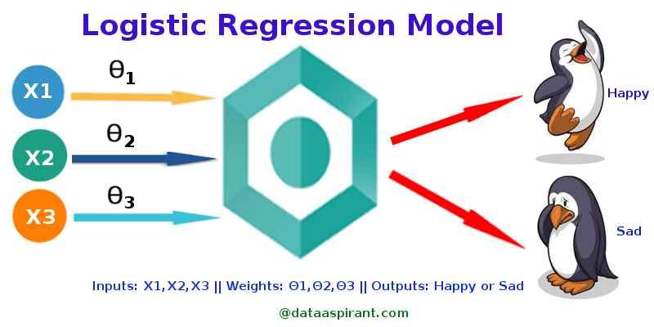
Base learner model
Why Logistic Regression ???
We have taken the Logistic Regression model as our base learner model for this project.
Advantages of Logistics Regression :
Logistic Regression Are very easy to understand
It requires less training
Disadvantages of Logistics Regression :
Sometimes Lot of Feature Engineering Is required
If the independent features are correlated it may affect performance
It is often quite prone to noise and overfitting
Name | Train Score | Test Score | Precision Score | Recall Score | F1-Score | ROC - AUC | TN | FP | FN | TP
Logistic Regression | 0.76934 | 0.77139 | 0.56264 | 0.25618 | 0.35207 | 0.76518 | 2718 | 185 | 691 | 238
Metrics Report =>
From the above results we can see that the Logistic Regression model is performing quite ok is we consider the train and test scores but as we go on to analyze the precision ,recall and f1-scores we can find that it is doing a terrible job at classification as we can even see high False Negatives.

Slide 9
Feature Analysis
From the respective feature importance analysis of the Logistic regression model we can conclude that the company_type _other holds the highest importance among all the other features in the case of Logistic Regression model.

Slide 10
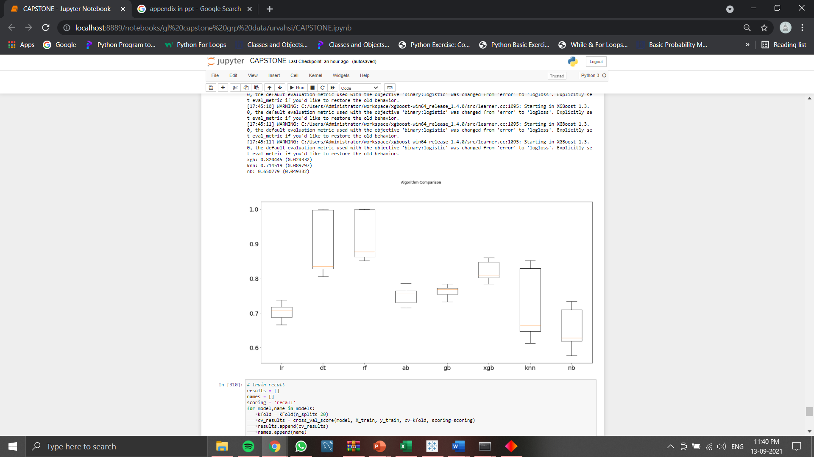
Algorithm comparison
Here we can observe the models with different scores as per their performances.
We can clearly see that most of the models in which have been applied on out datset have a high variance which is not good for a generealized model.
Random Forest and Decsion Tree have the highest metrics but have high variance so we wont use them.
We can see XGBoosting Algoritm but it also has a high variance so we will remove it off the list and choose the Gradient Boosting which seems to be a more stable and generalized algorithm.

Slide 11
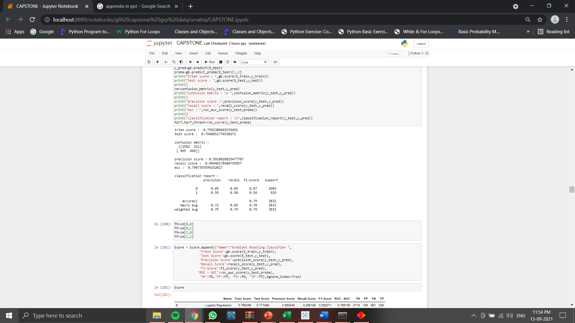
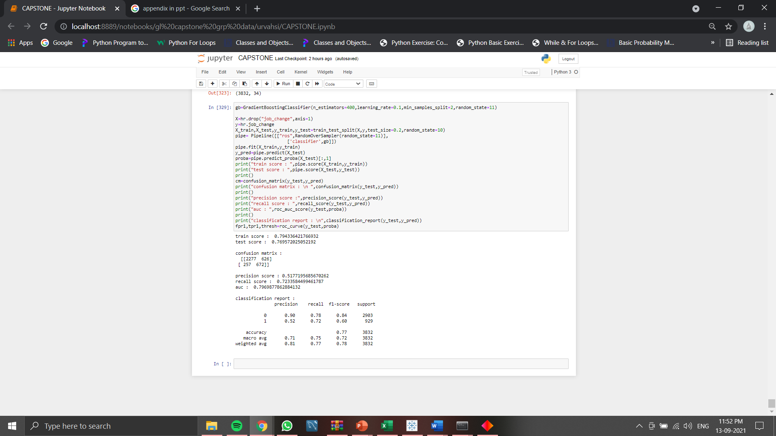
Before Over Sampling
and hyperparameter
tuning
After Over Sampling and
hyperparameter
tuning
We can clearly observe the difference in the two, after oversampling and hyperparameter tuning not only the overfitting of the data and there is difference in test and train score as well as we can see that there has beena significant increase in the recall score after performing the following steps.

Slide 12
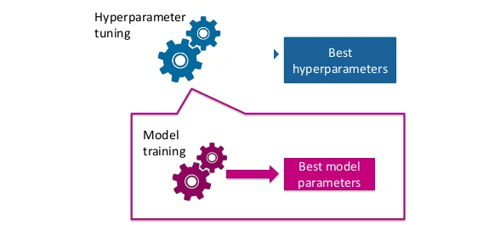
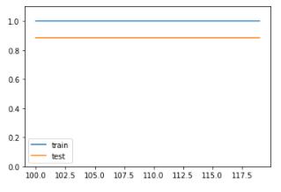
Hyper Parameter tuning
In machine learning, hyperparameter optimization or tuning is the problem of choosing a set of optimal hyperparameters for a learning algorithm. A hyperparameter is a parameter whose value is used to control the learning process.
Random Forest Hyper Parameters:
Max_Depth: The max_depth of a tree in Random Forest is defined as the longest path between the root node and the leaf node
As The method for hyperparameter tuning is trail and error method so we will use Validation curves to narrow down the search for best parameter for the model.
Validation Curves
A Validation Curve is an important diagnostic tool that shows the sensitivity between to changes in a Machine Learning model’s accuracy with change in some parameter of the model.
Max_depth : Here for the validation curve we can observe that after the max depth curve stays constant.so it wont matter even if we increase the max depth more than 100.

Slide 13
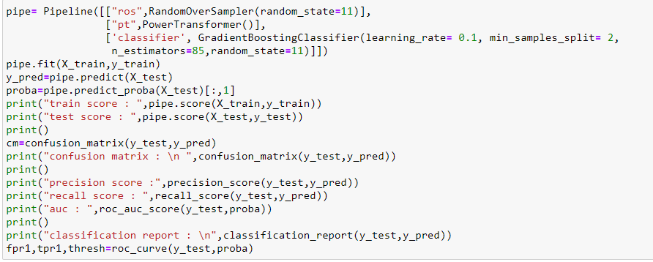
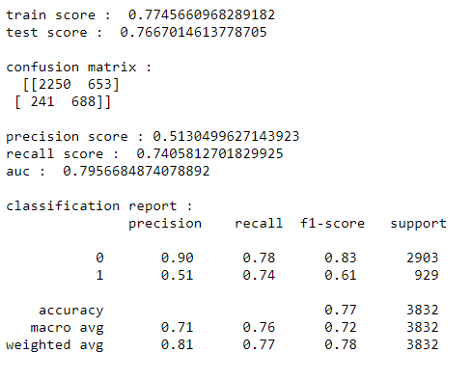
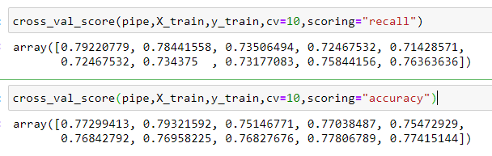
Final models parameters for the Random Forest model after considering the results from the validation curve are :
Learning_rate=0.1 (as the curve does not increase )
min_samples_split=2 (to reduce the overfitting a bit)
n_estimators=85 (the curve increases with the increase in number of estimators)
Hyper Parameter tuned Model Score CV
Recall
Accuracy

Slide 14
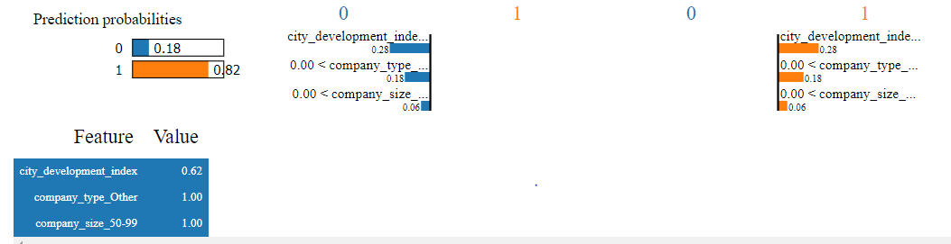
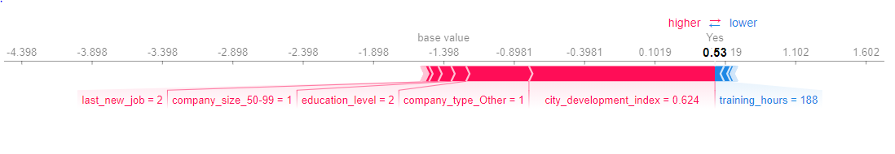
INTERPRETABILITY
LIME : LIME stands for Local Interpretable Model-Agnostic Explanations. It helps in defining a model for business users and to understand the
importance of features from a business perspective. Improving reliance on model
SHAP: SHAP allows you to see the directing effect of each input variable output and this gives the model user an important sense of how the model works.

Slide 15
Thanks!

